Slide 1

GEOG 4/590: Geospatial Data Science
Lecture 3: Network data analysis
Email: jryan4@uoregon.edu
Office: 163A Condon Hall
Office hours: Monday 15:00-16:00 and Tuesday 14:00-15:00

Slide 2
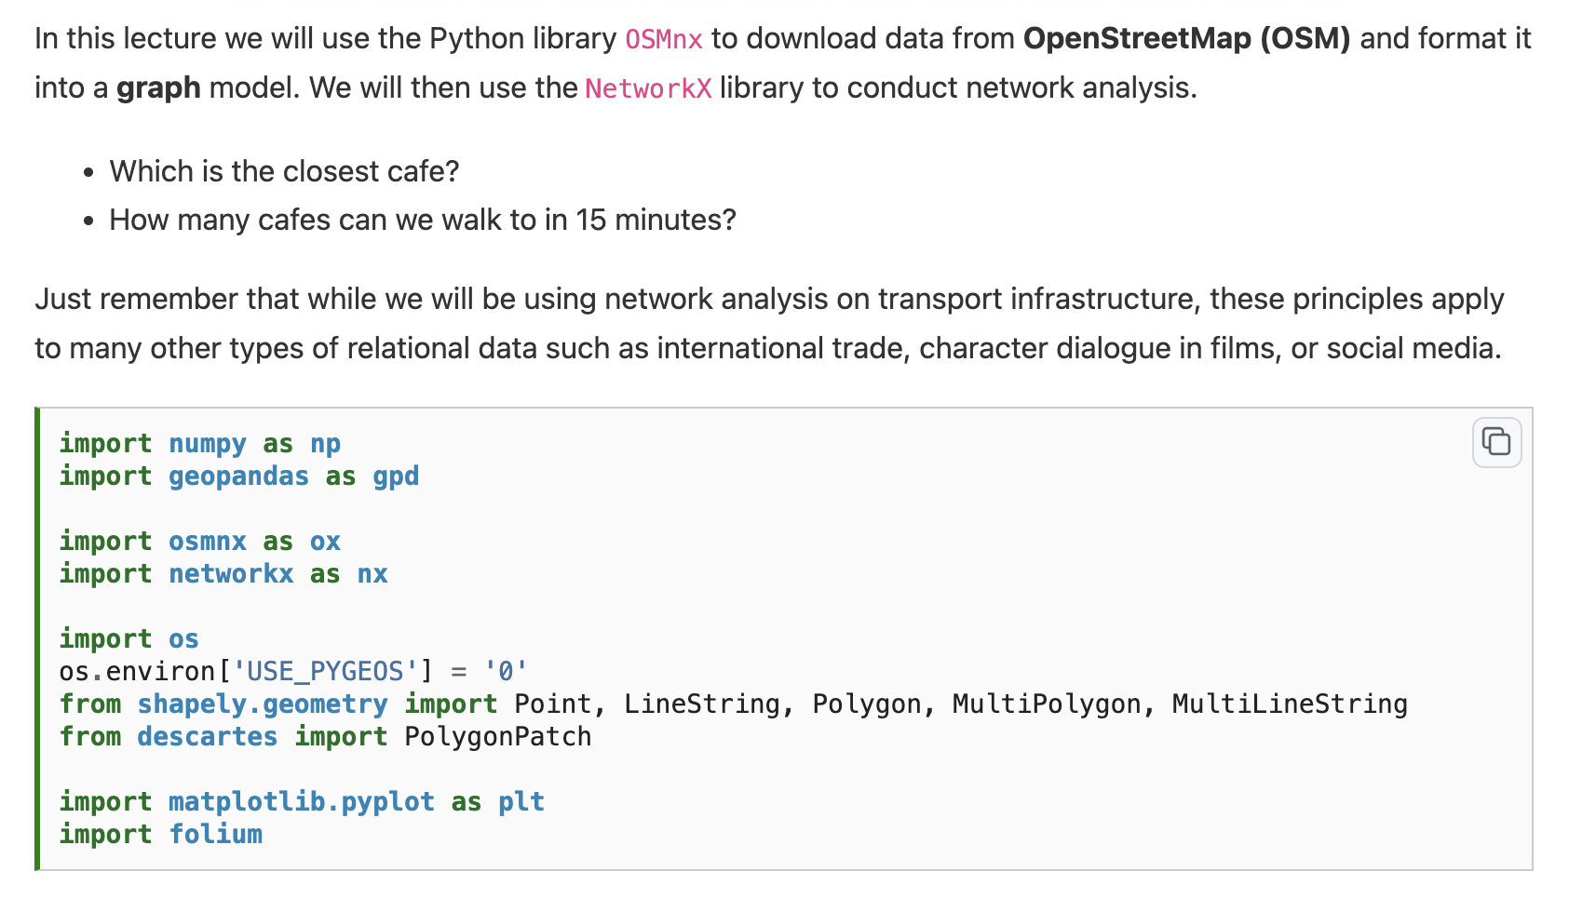

Slide 4
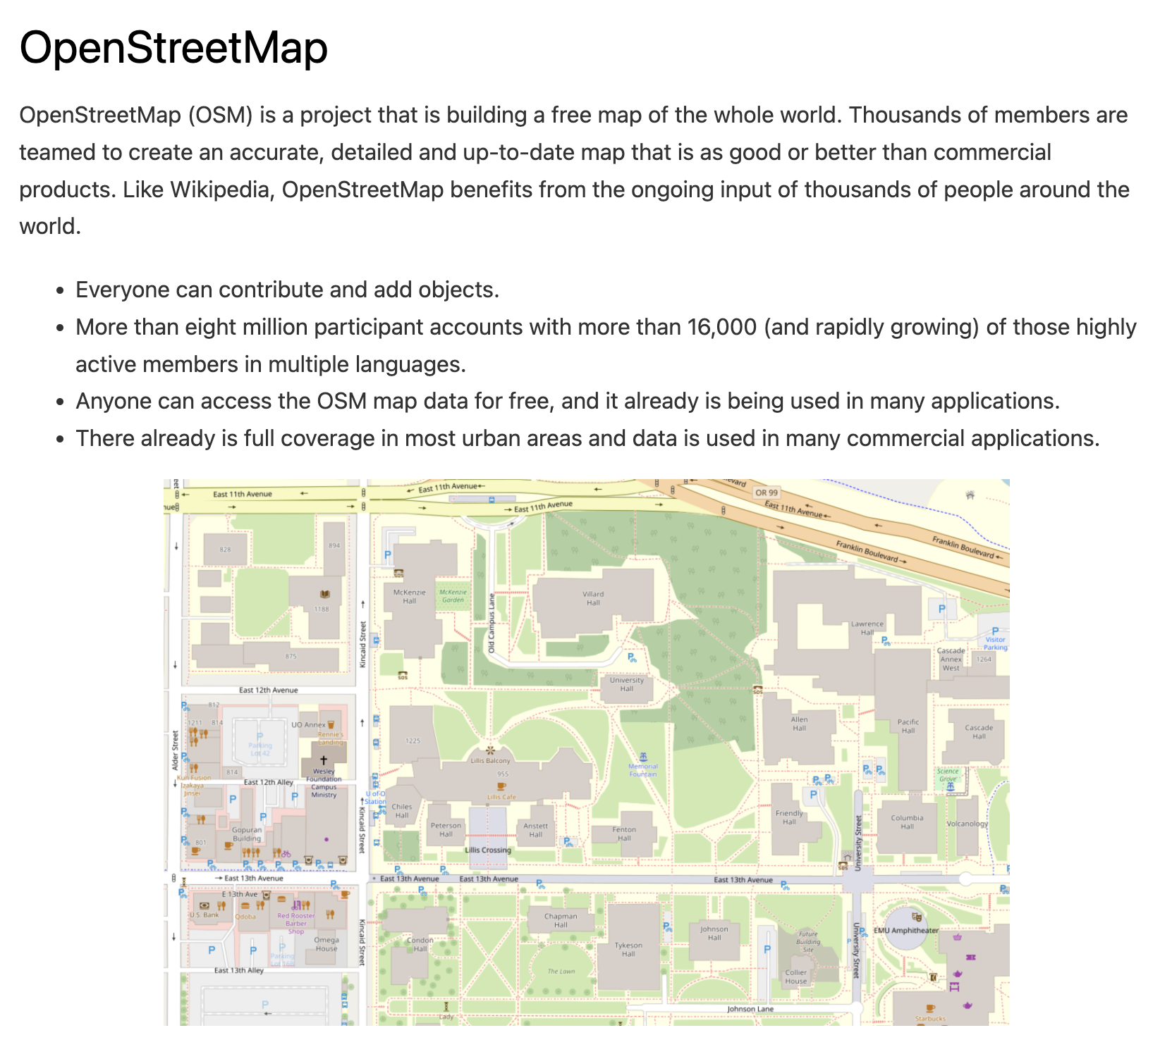

Slide 5
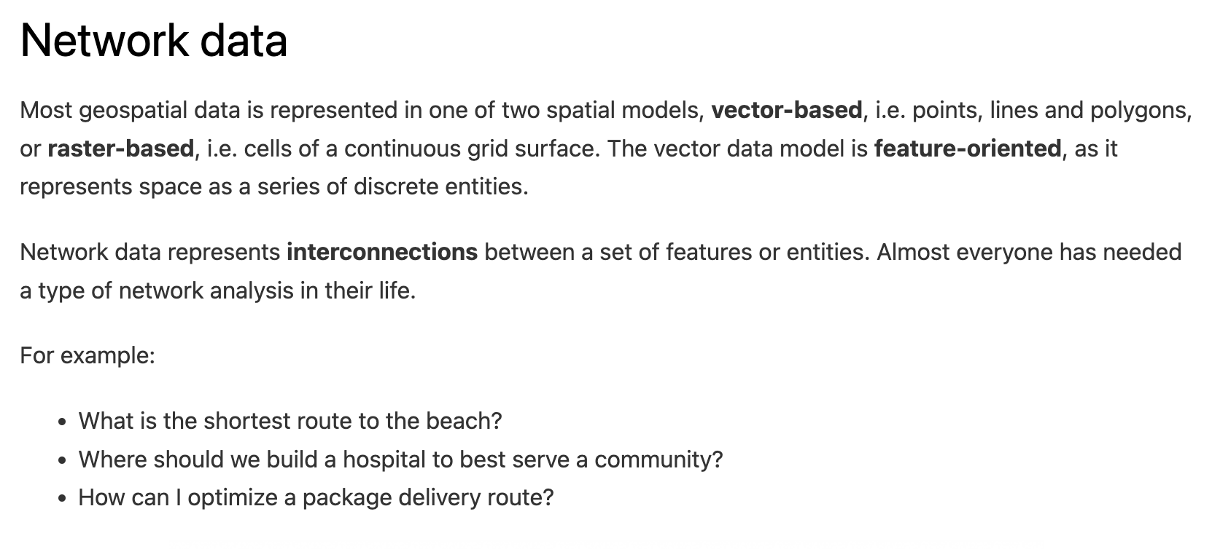
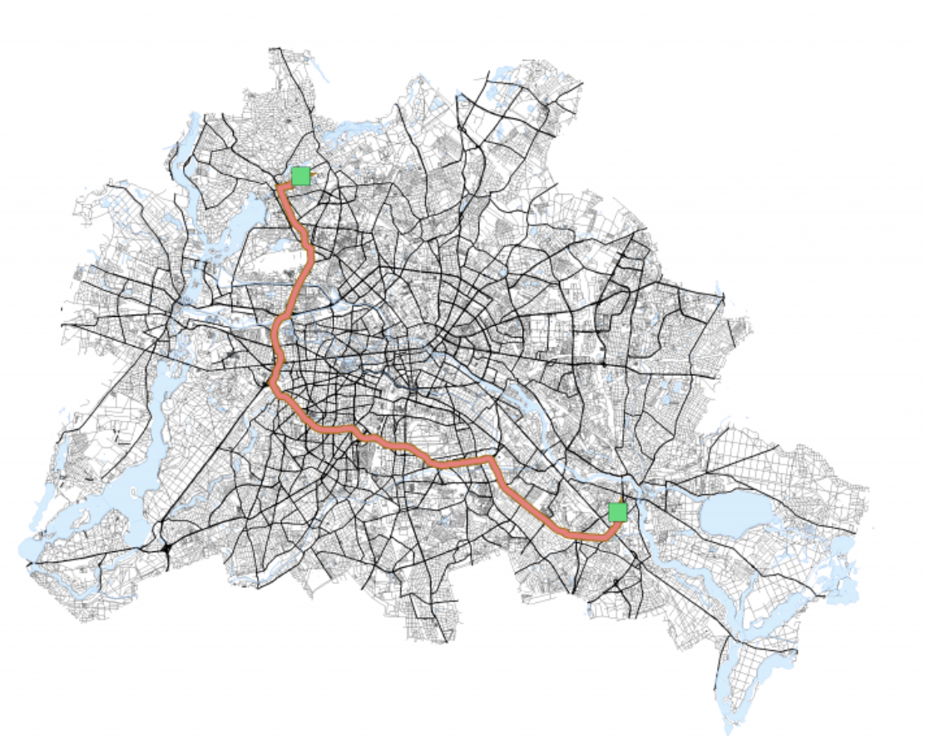

Slide 6
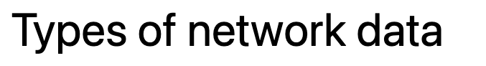
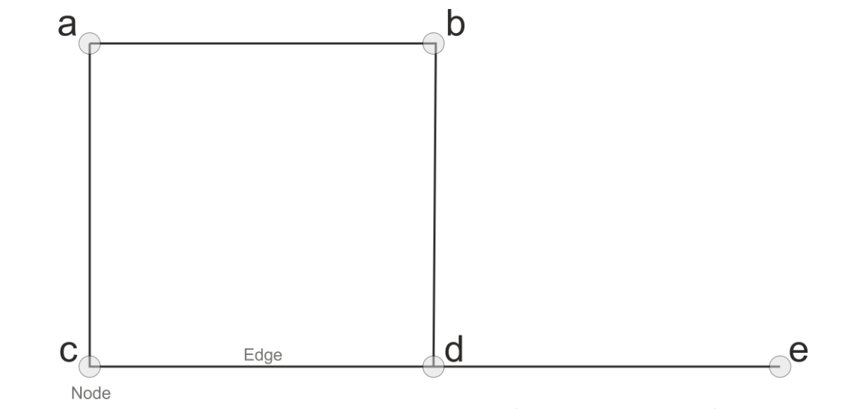

Slide 7
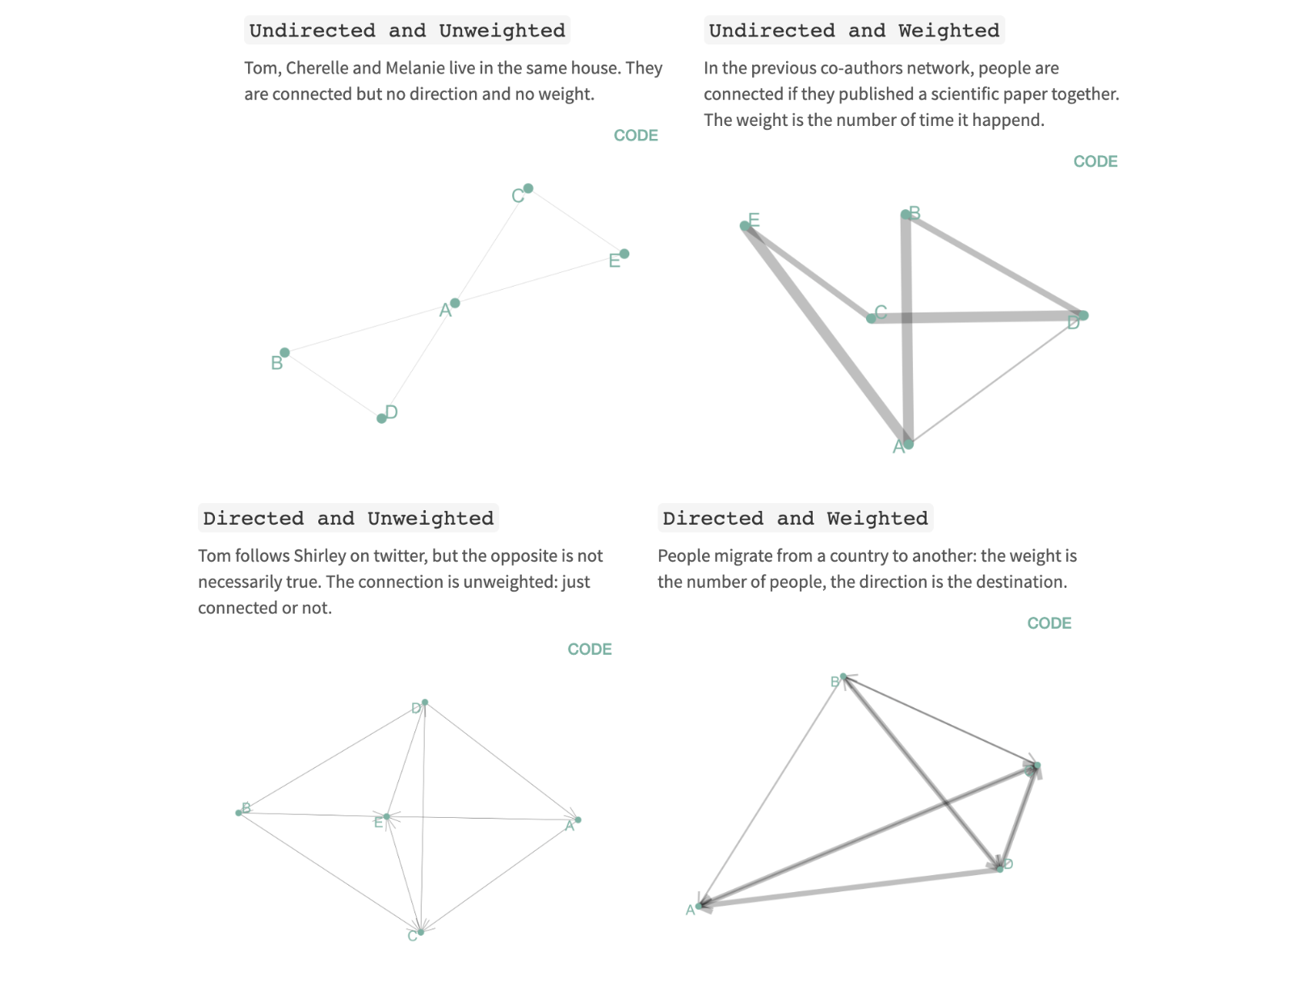

Slide 8


Slide 9
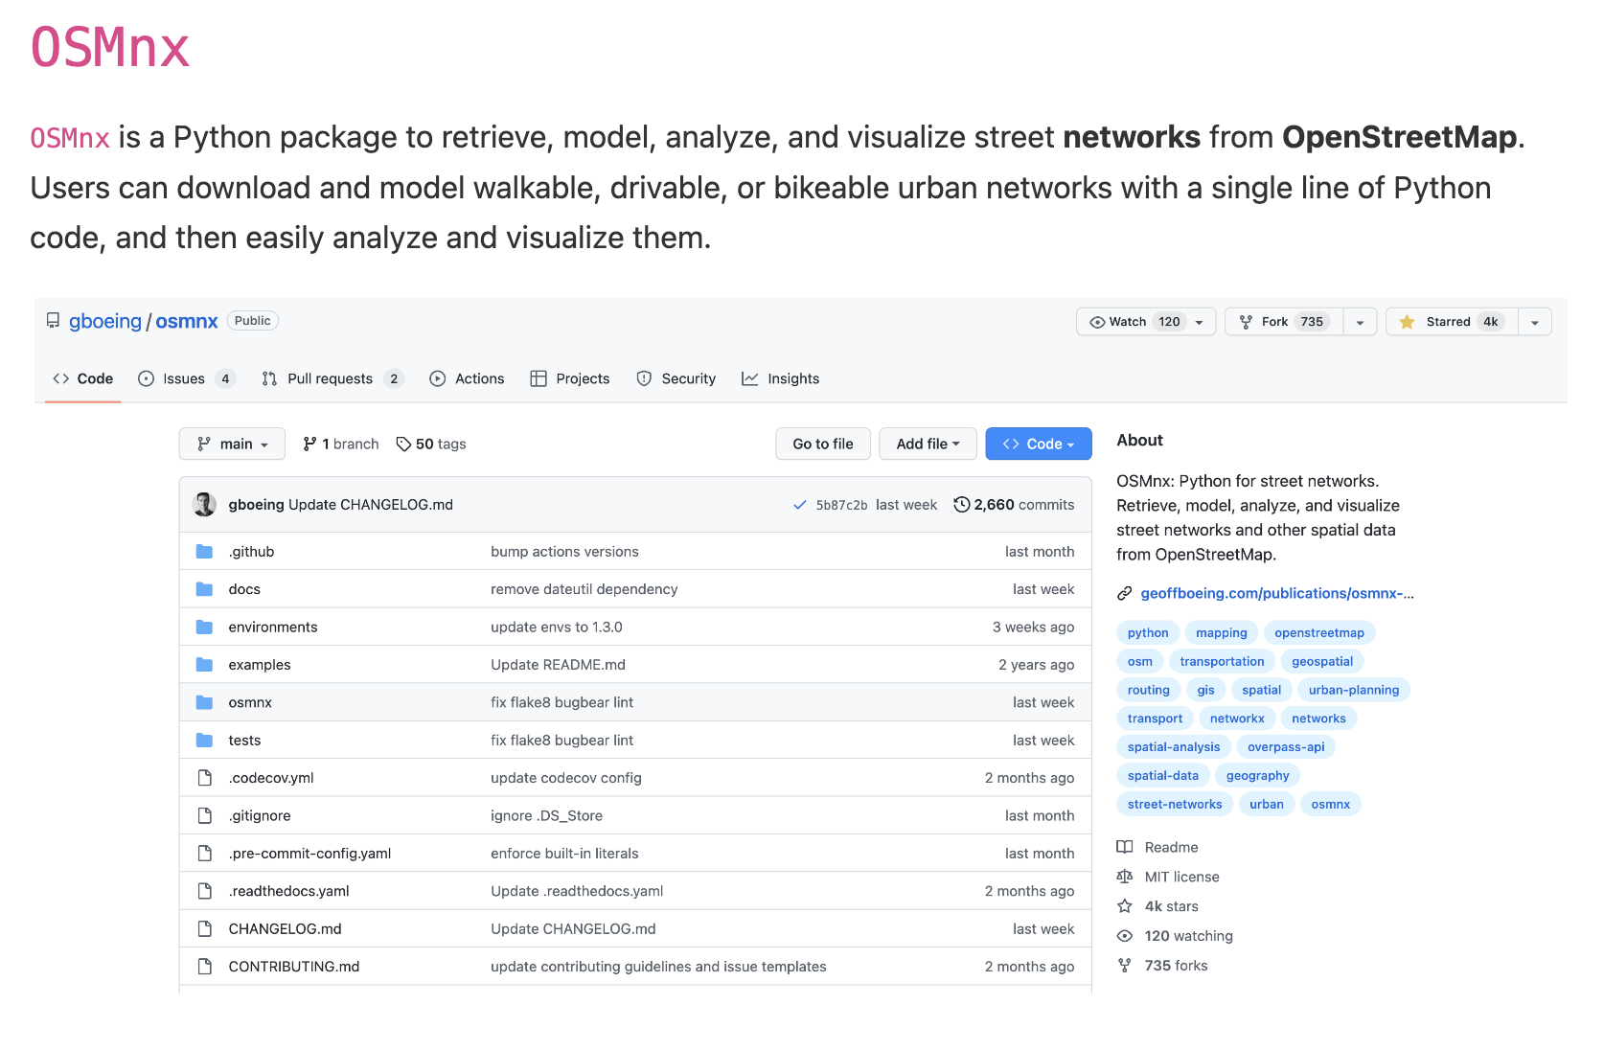

Slide 10
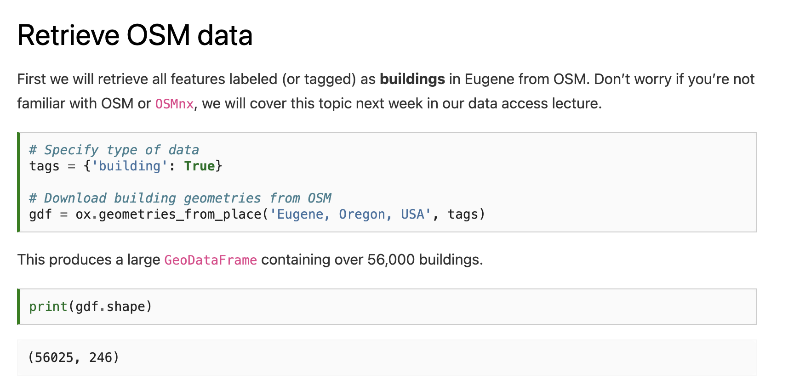

Slide 12
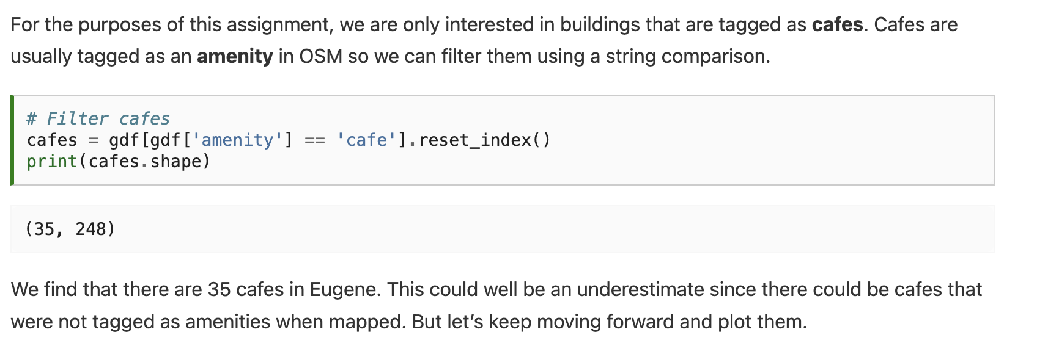

Slide 13
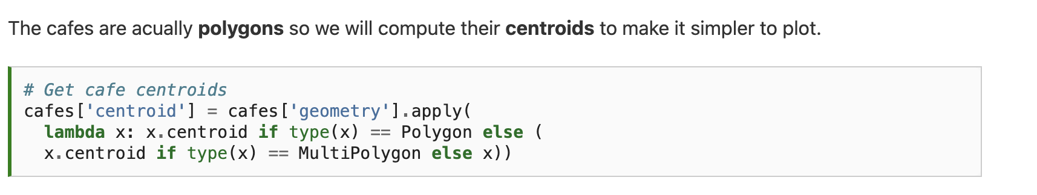

Slide 14
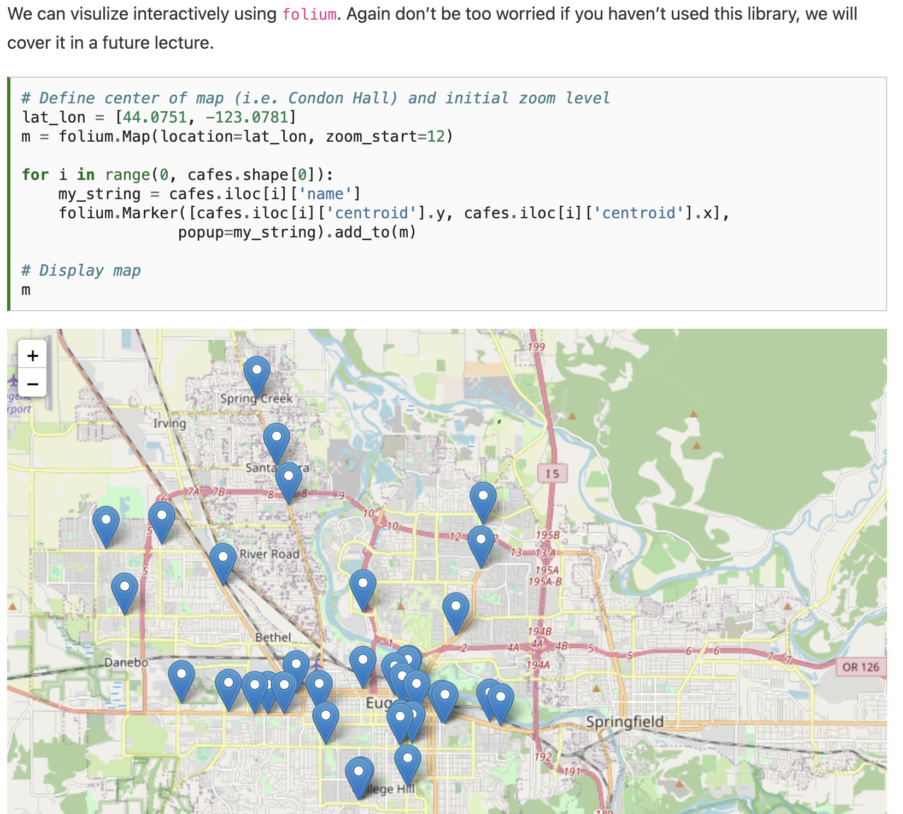

Slide 15
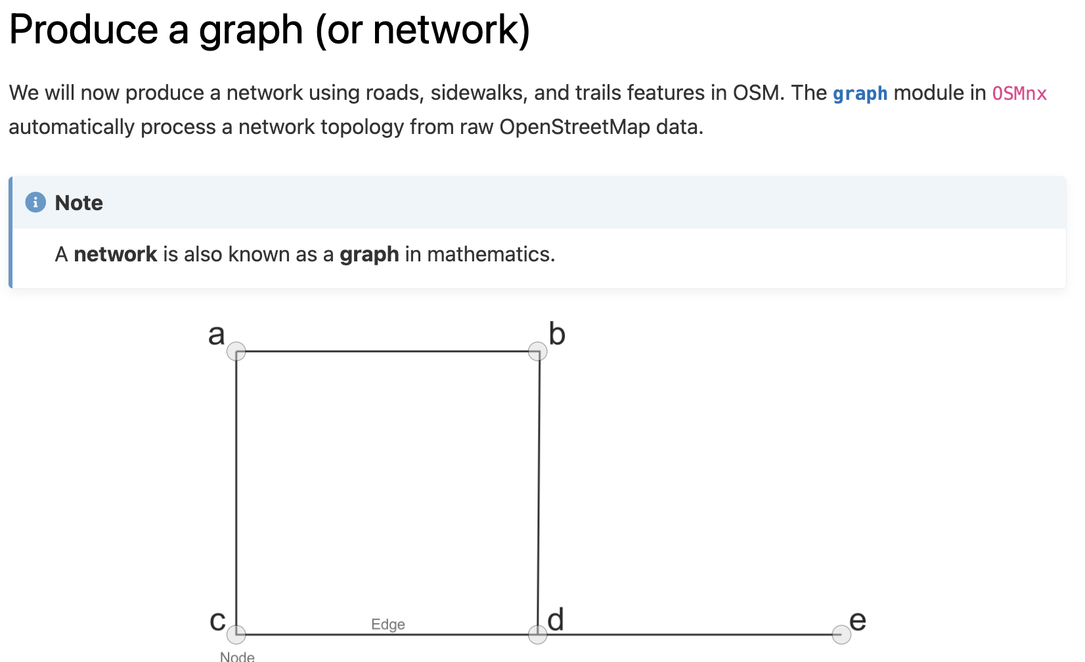

Slide 16
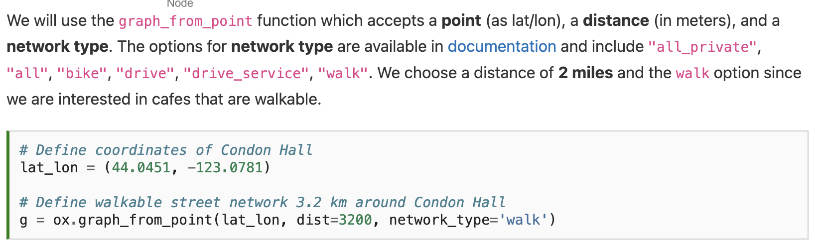

Slide 17
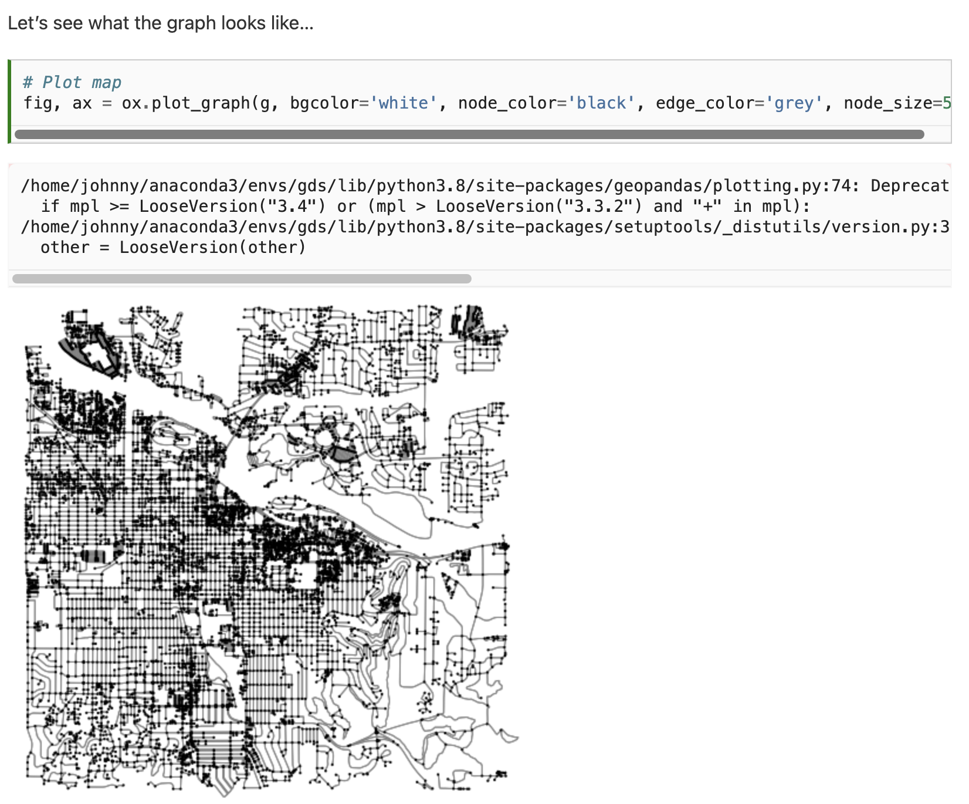

Slide 18
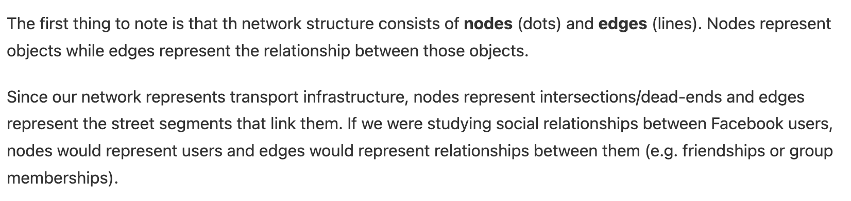

Slide 19
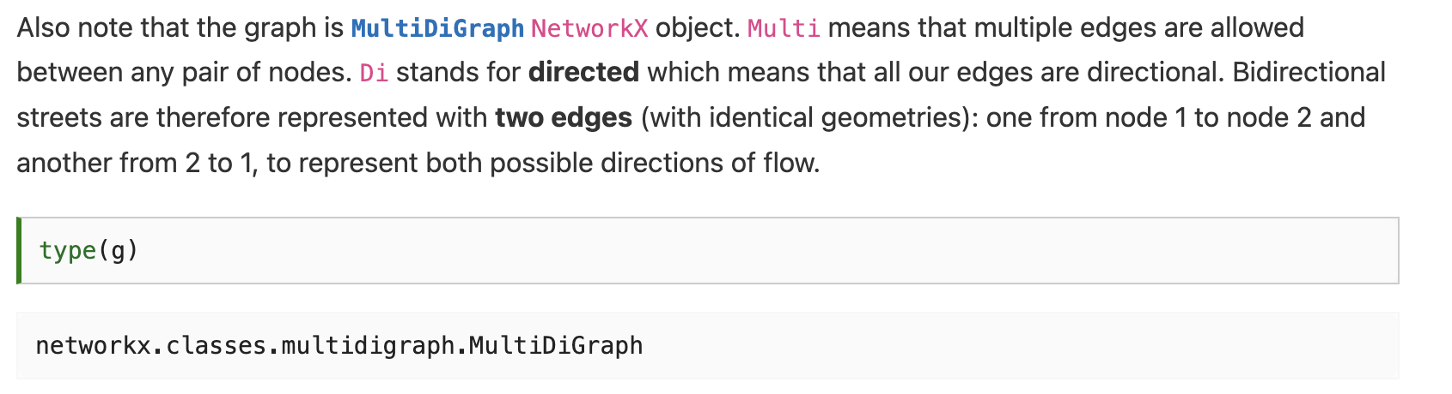

Slide 20
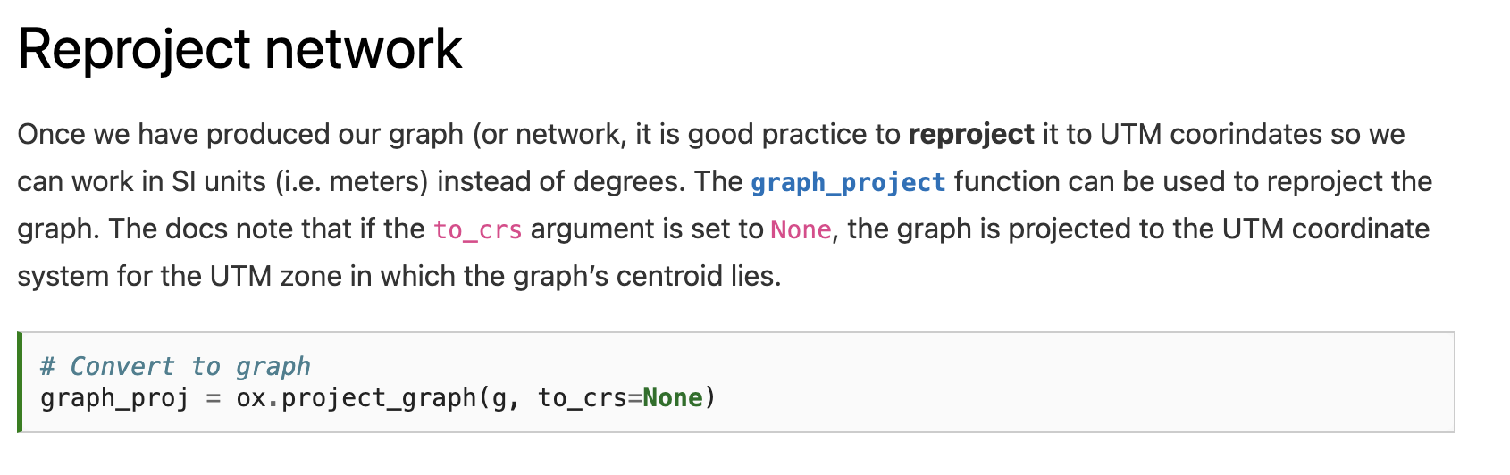

Slide 21
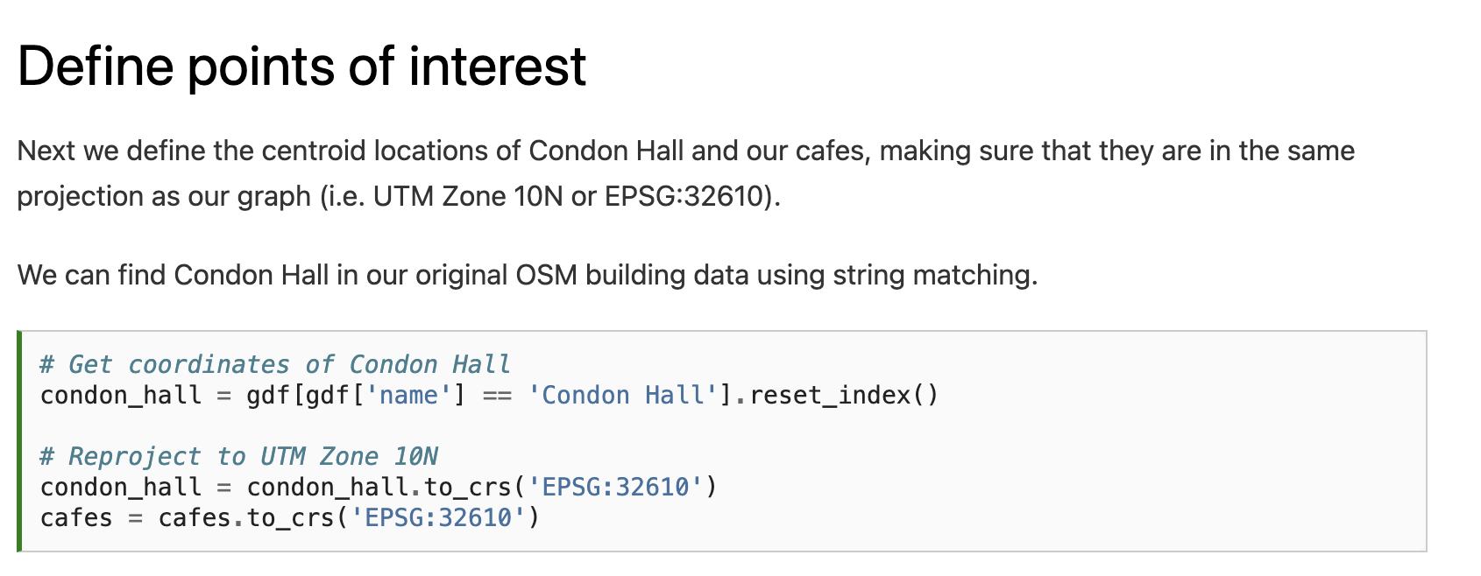

Slide 23
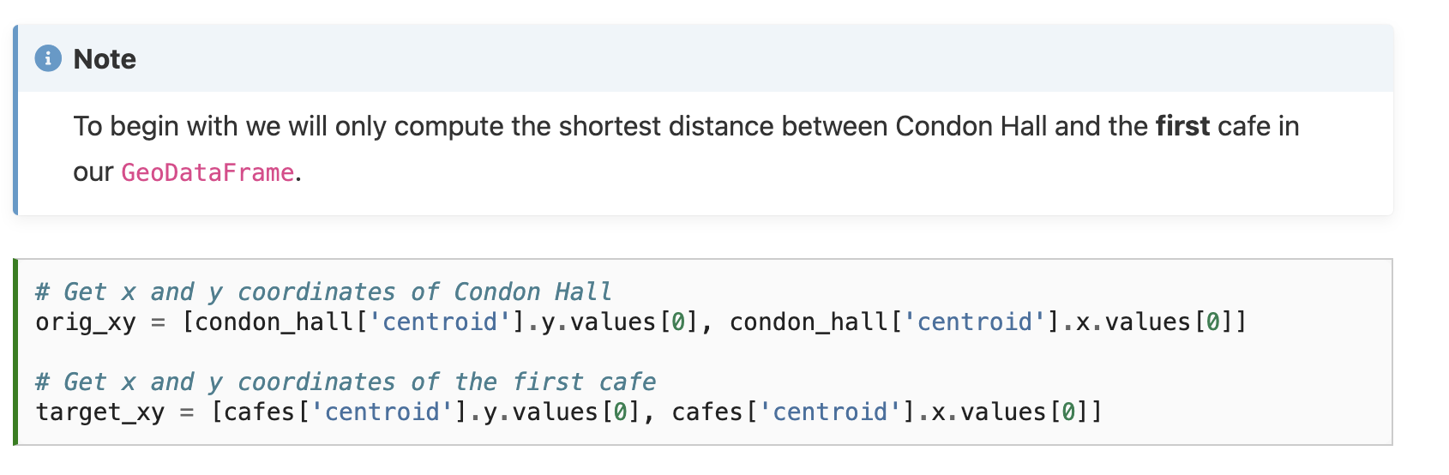

Slide 24
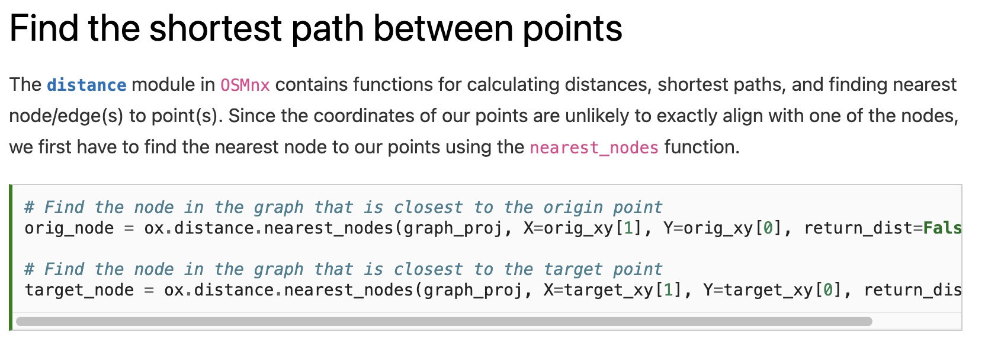

Slide 25
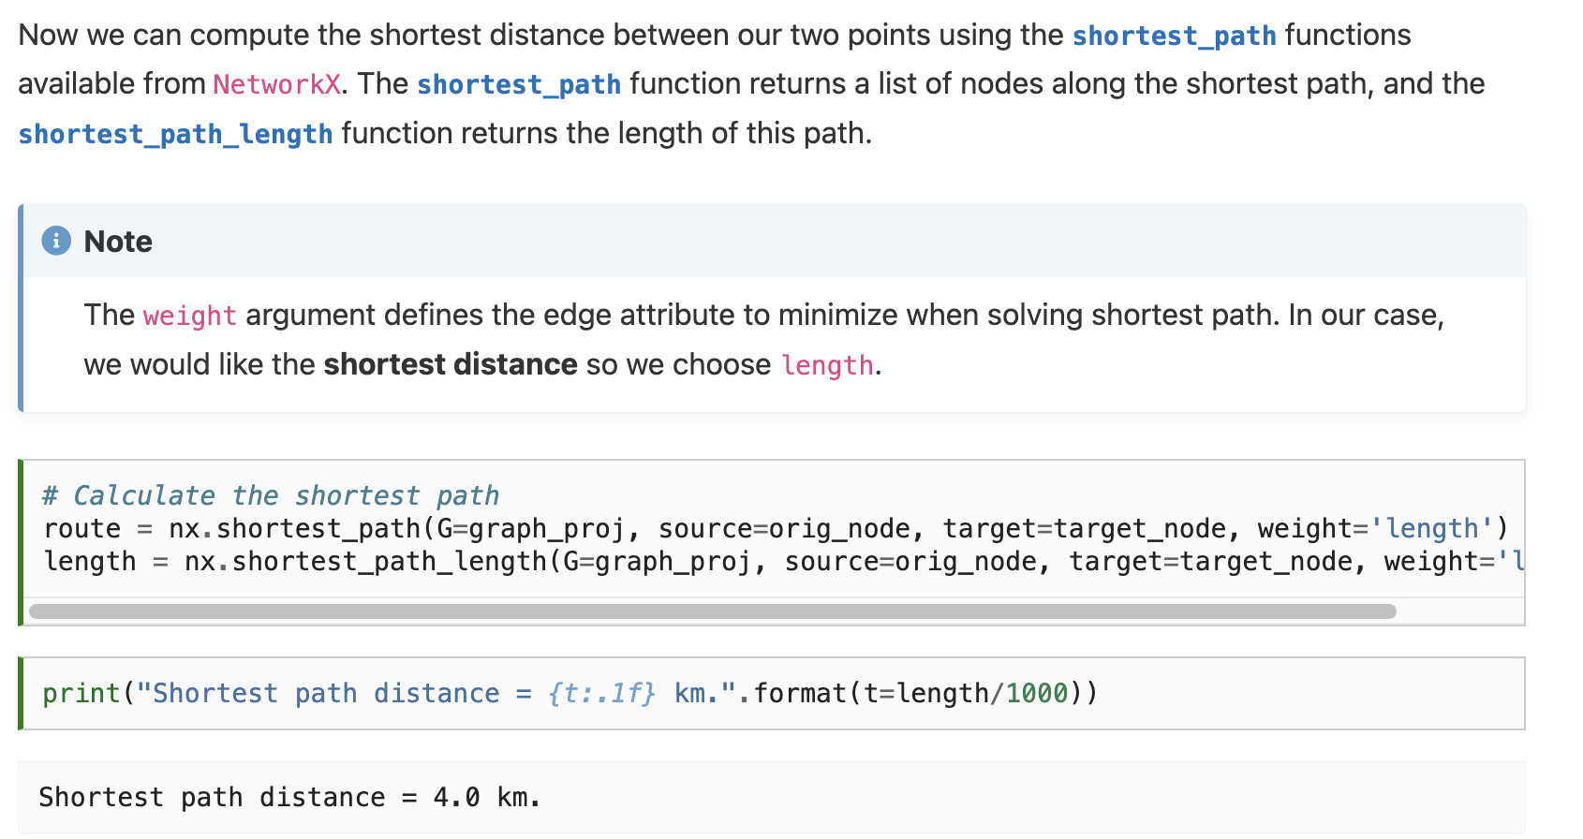

Slide 28
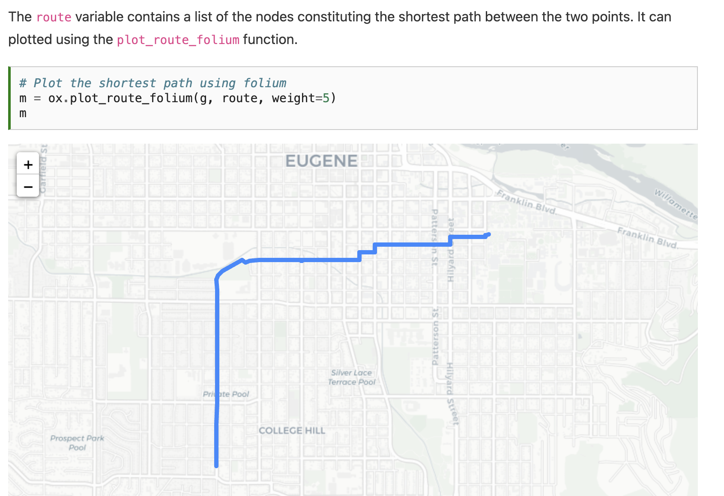

Slide 29
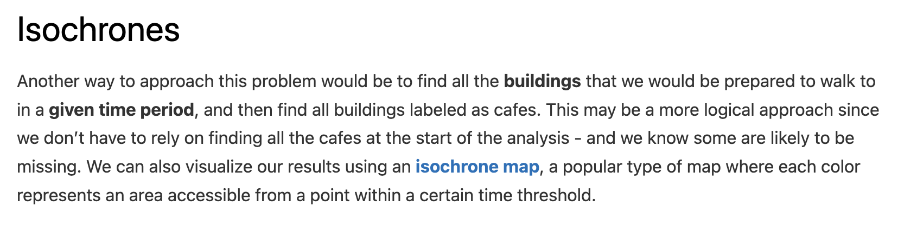

Slide 30
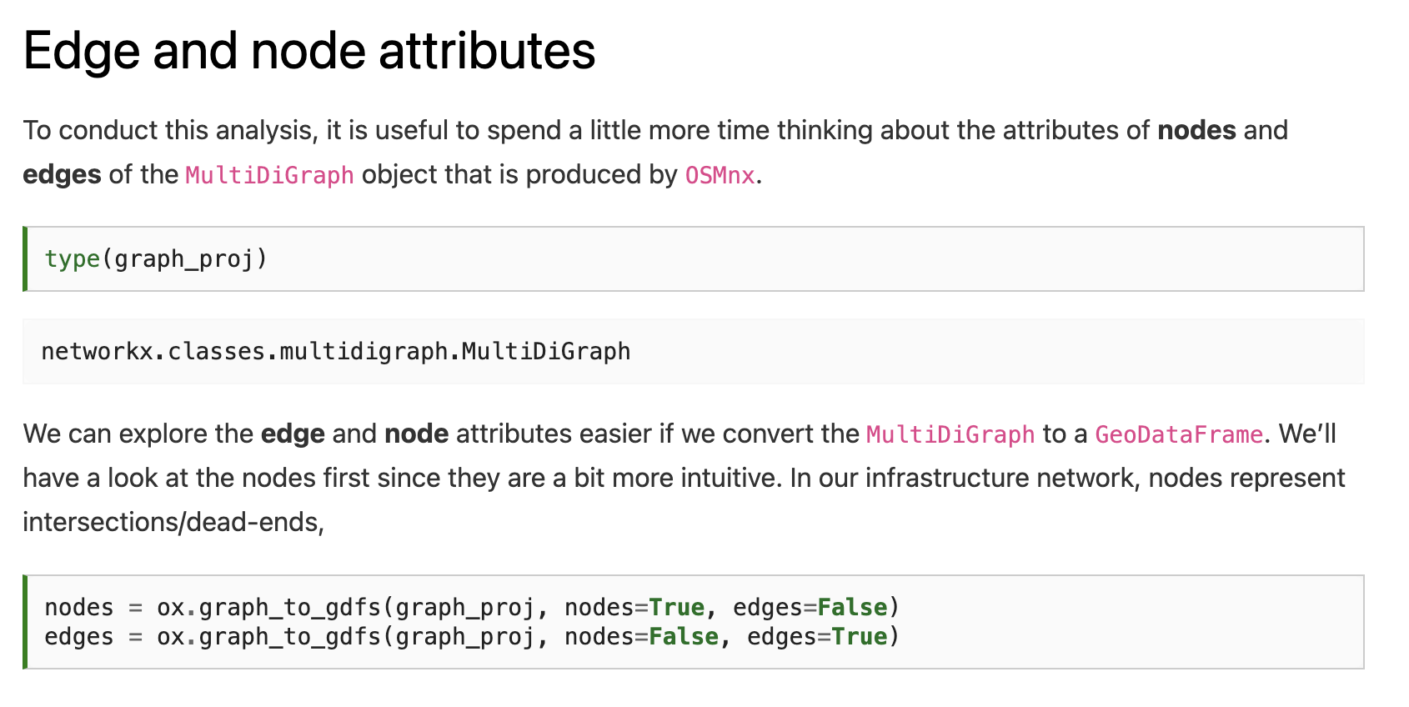

Slide 32
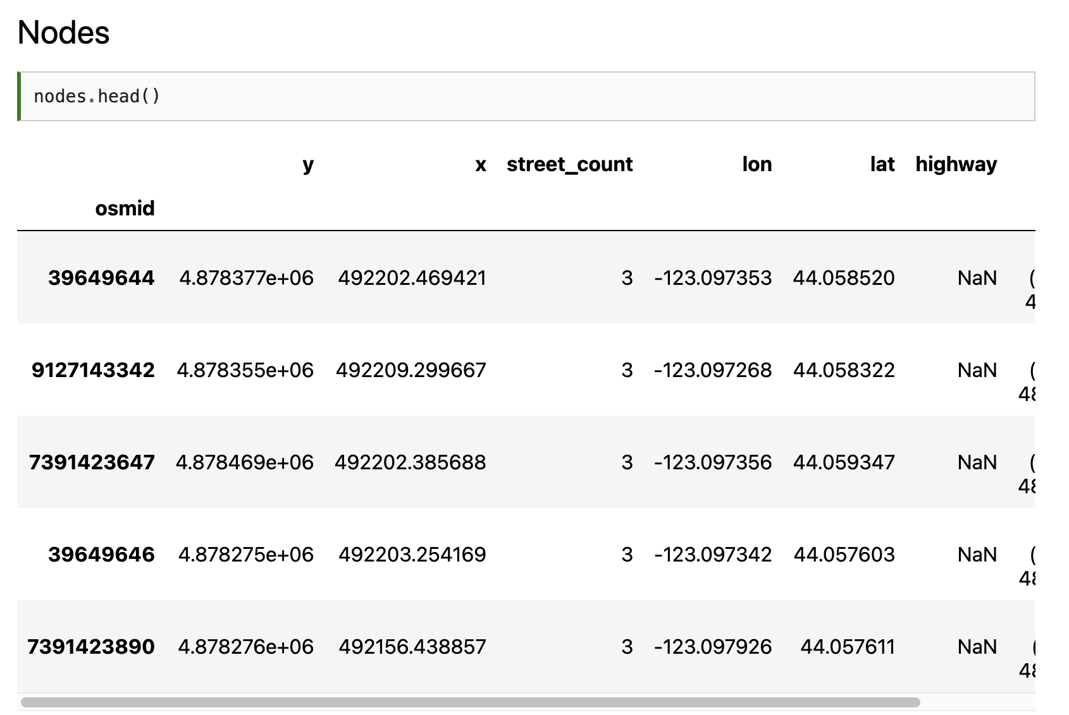
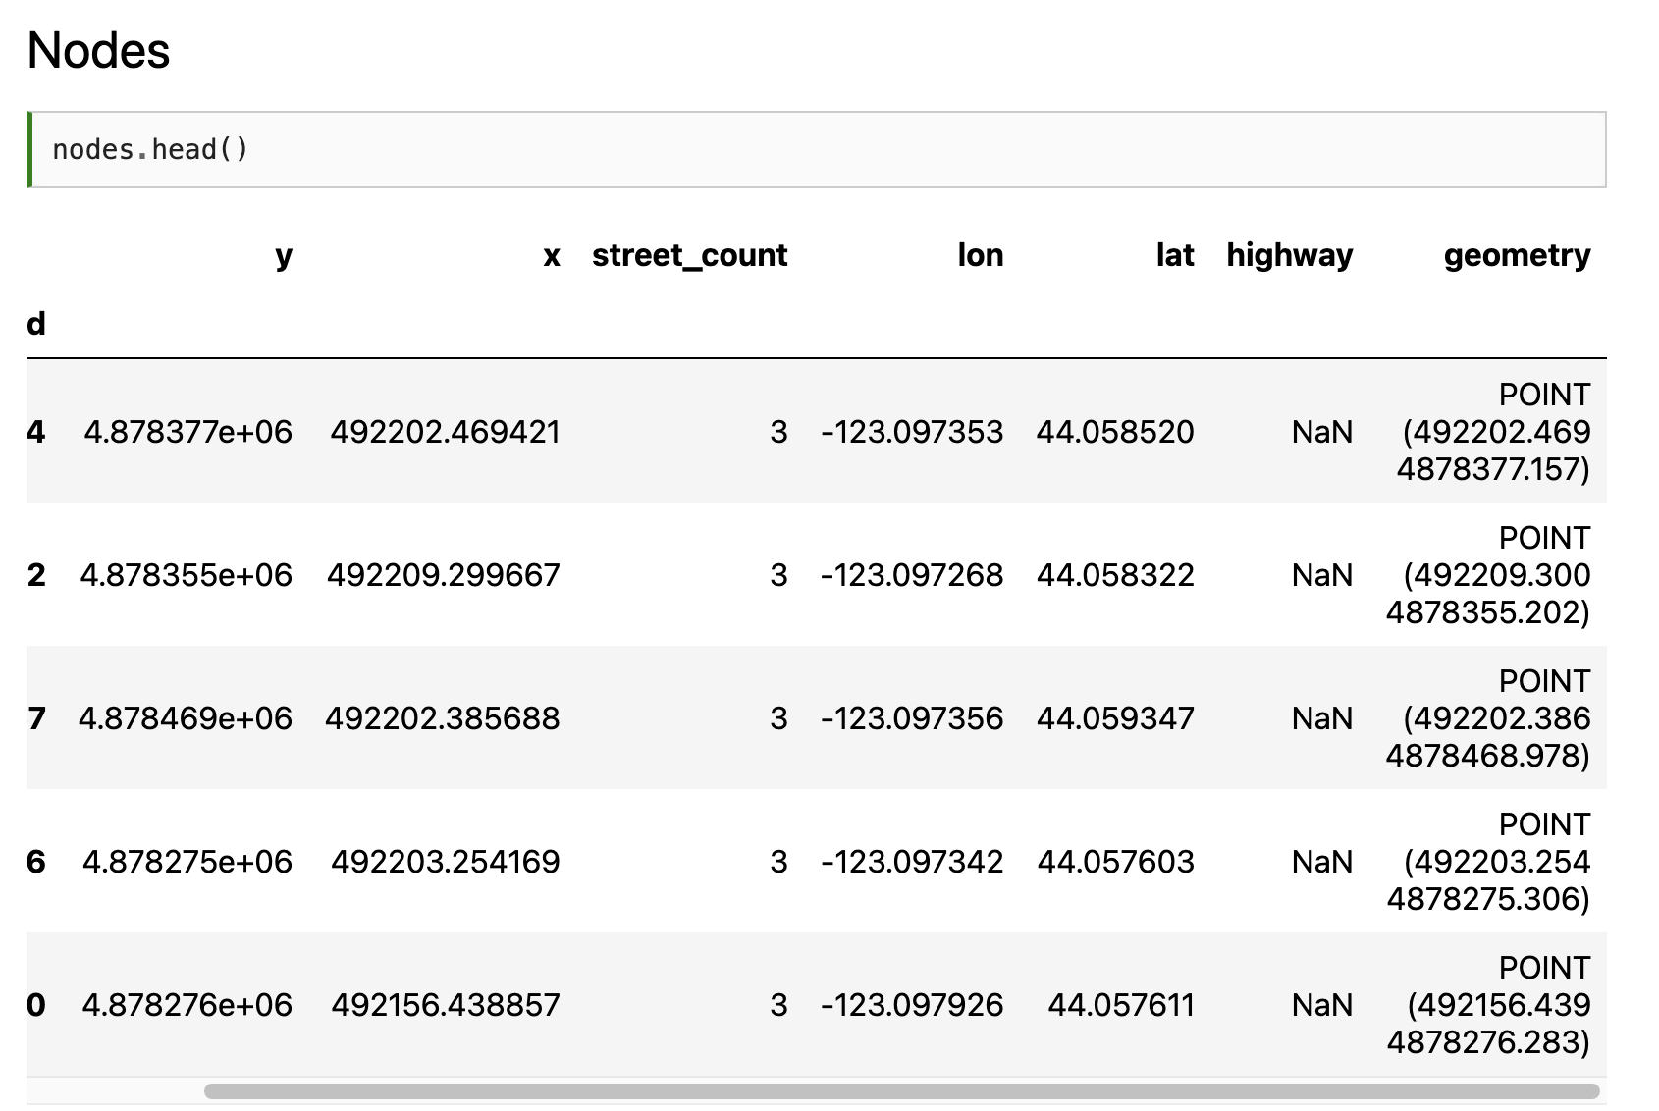

Slide 33
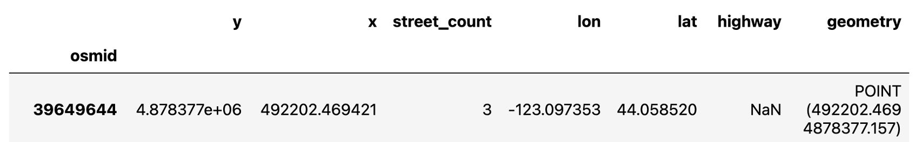
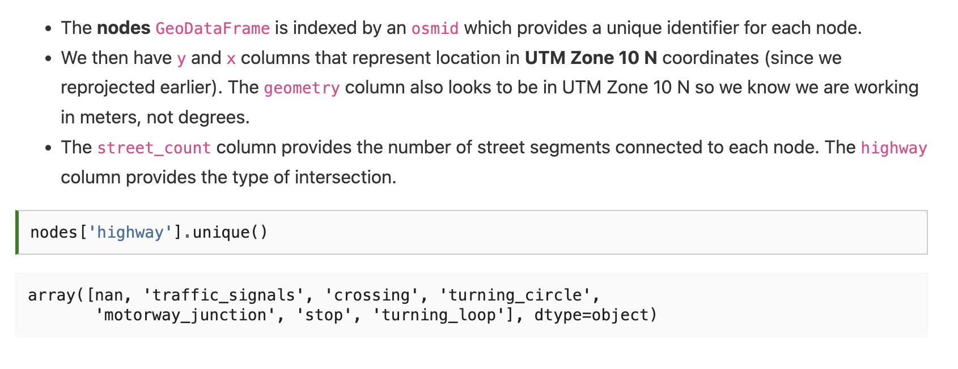

Slide 35
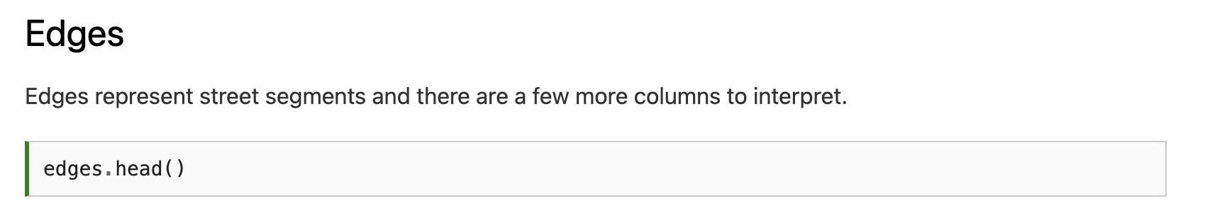
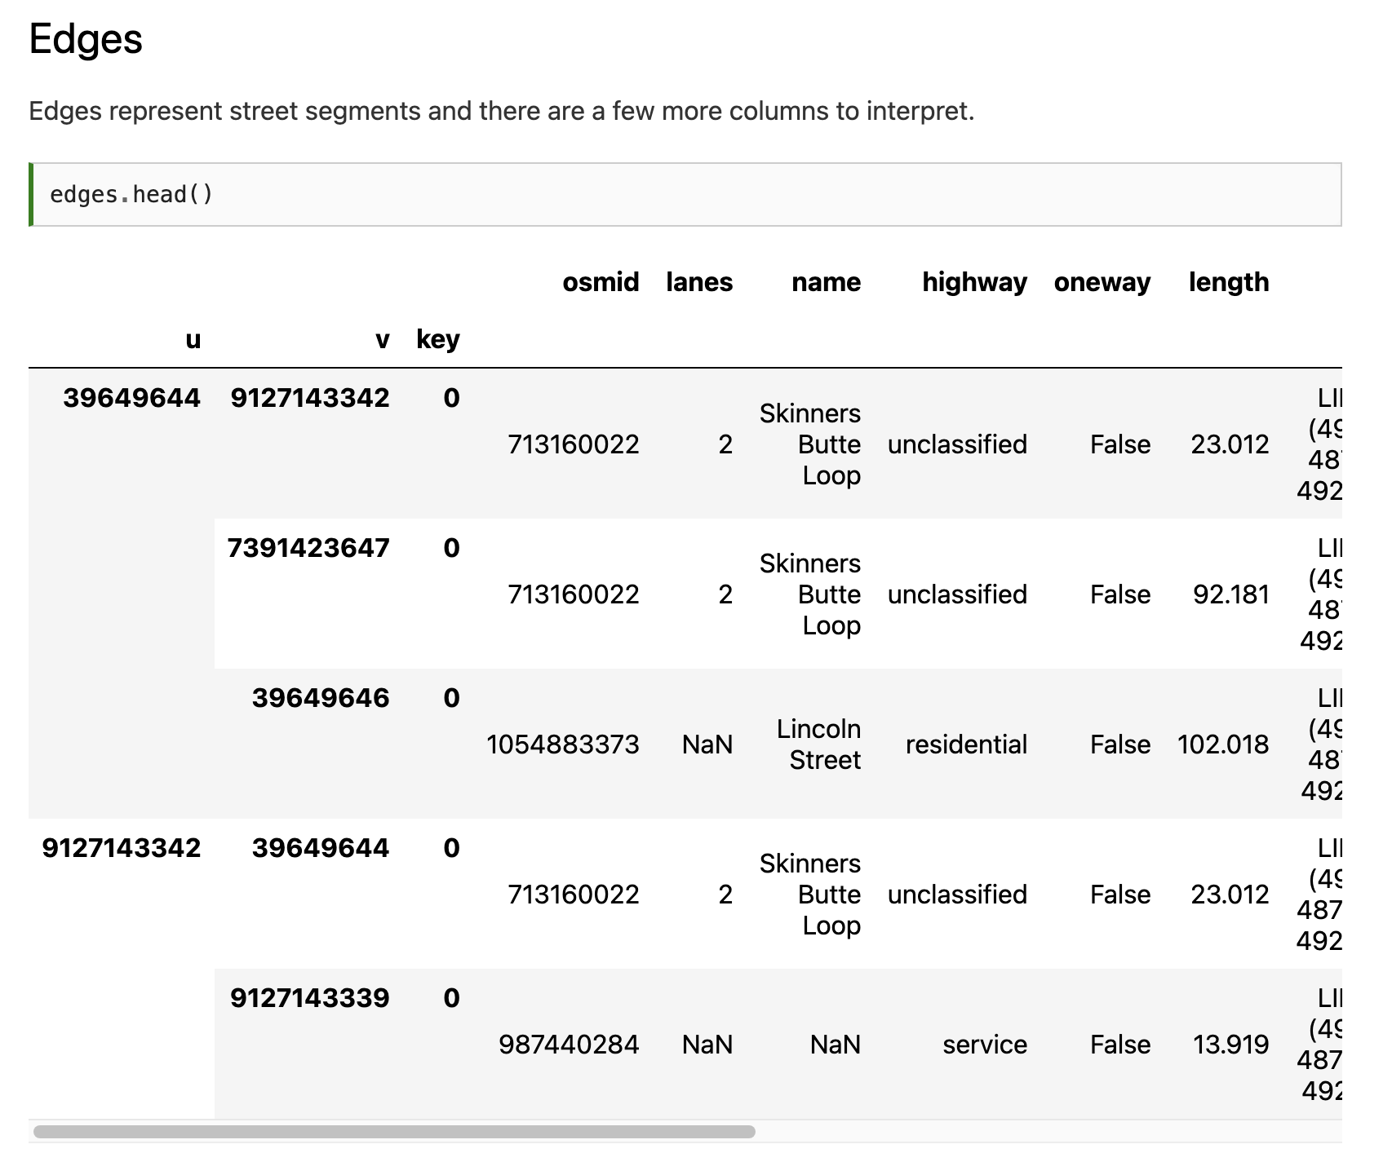
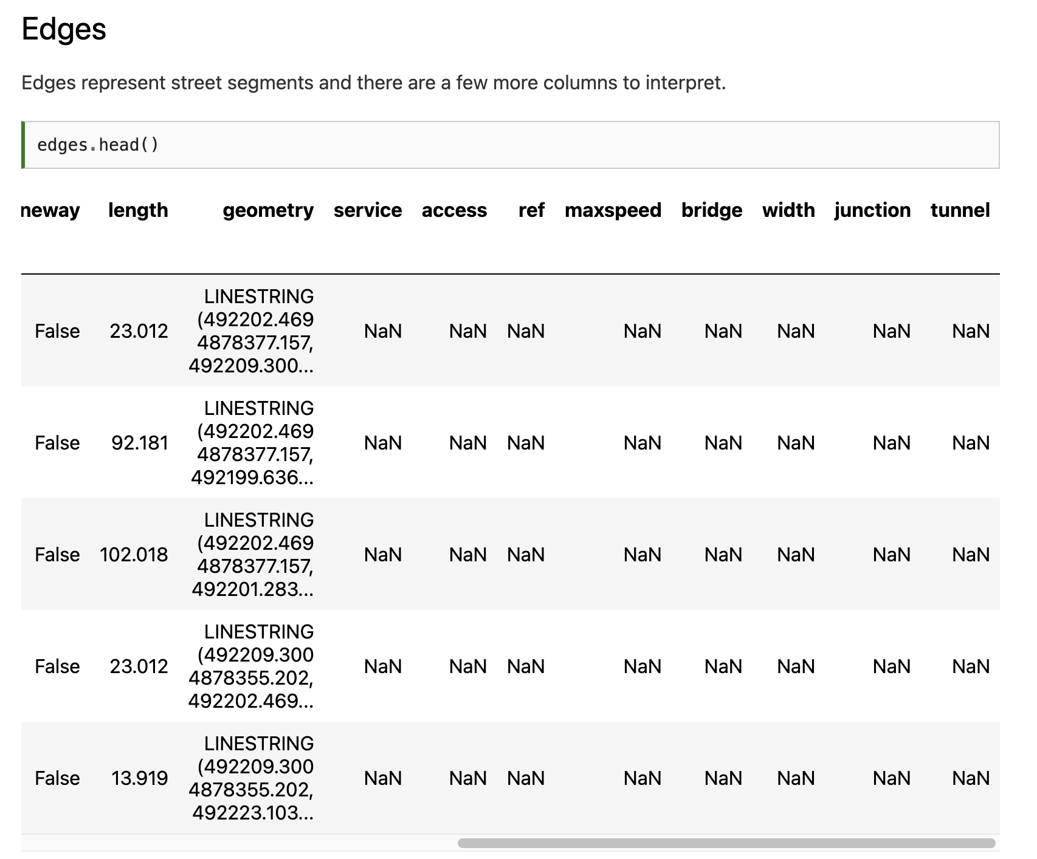

Slide 36
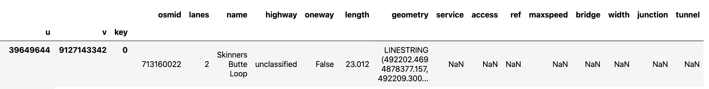
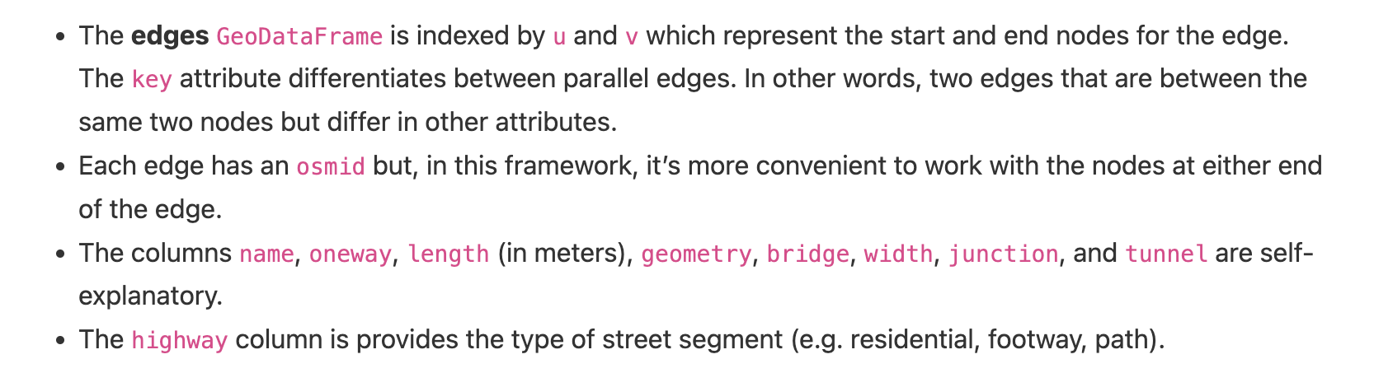

Slide 37
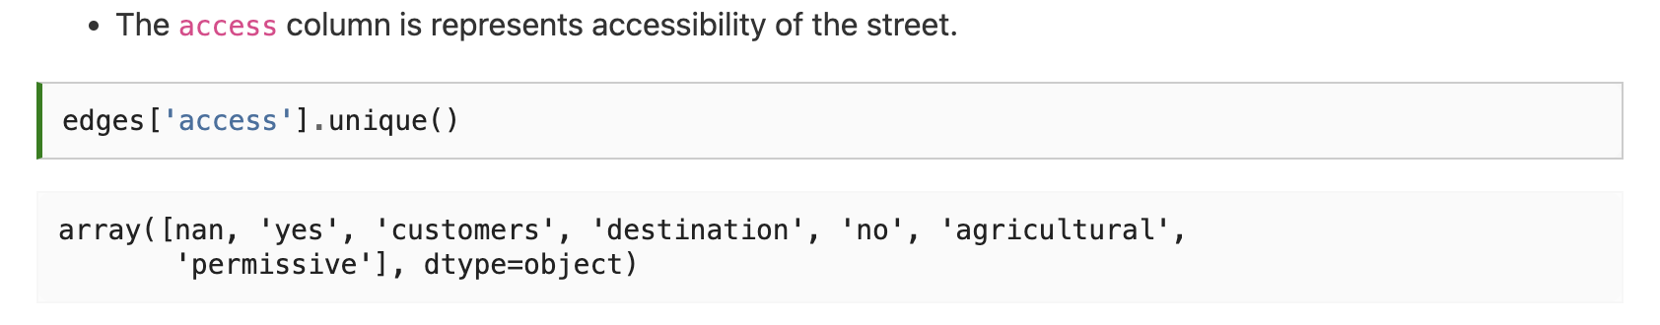

Slide 38
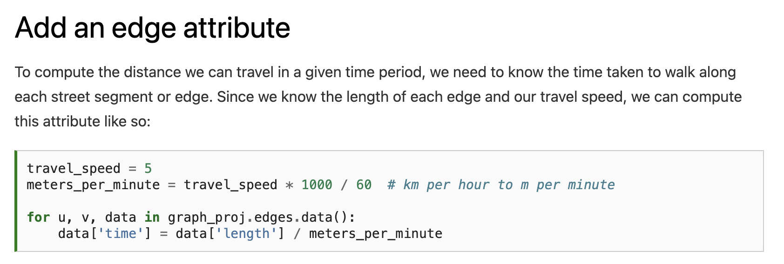

Slide 39
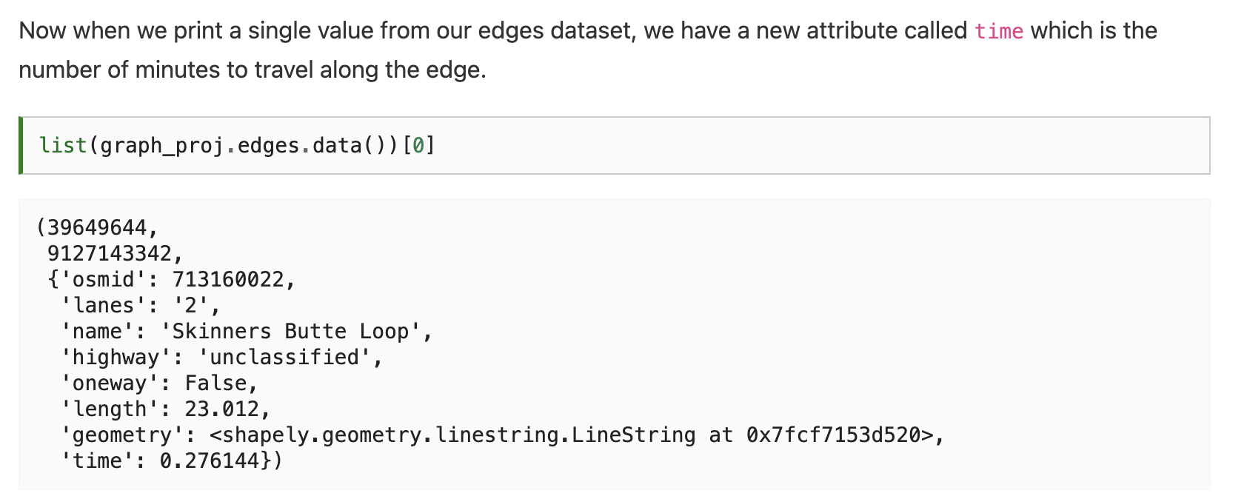

Slide 40
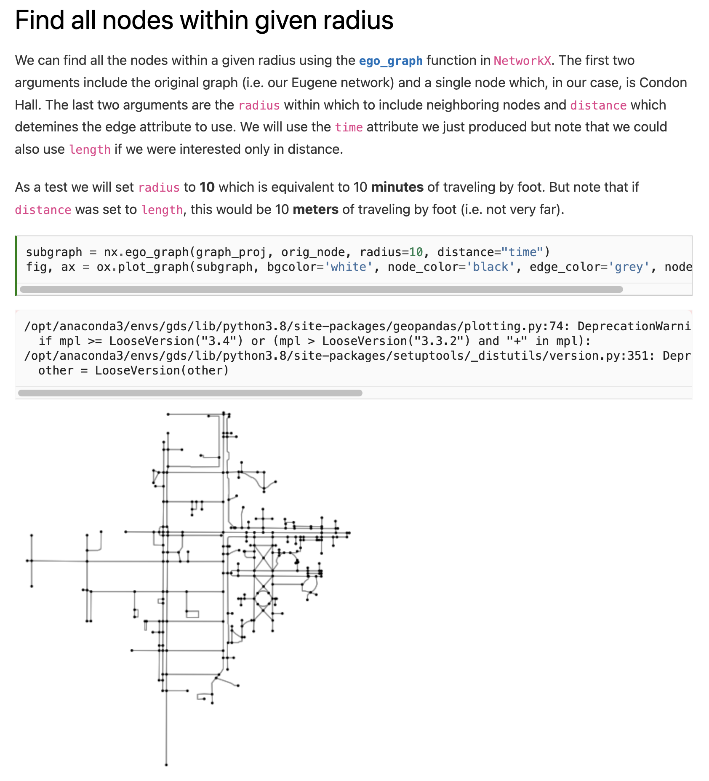

Slide 42
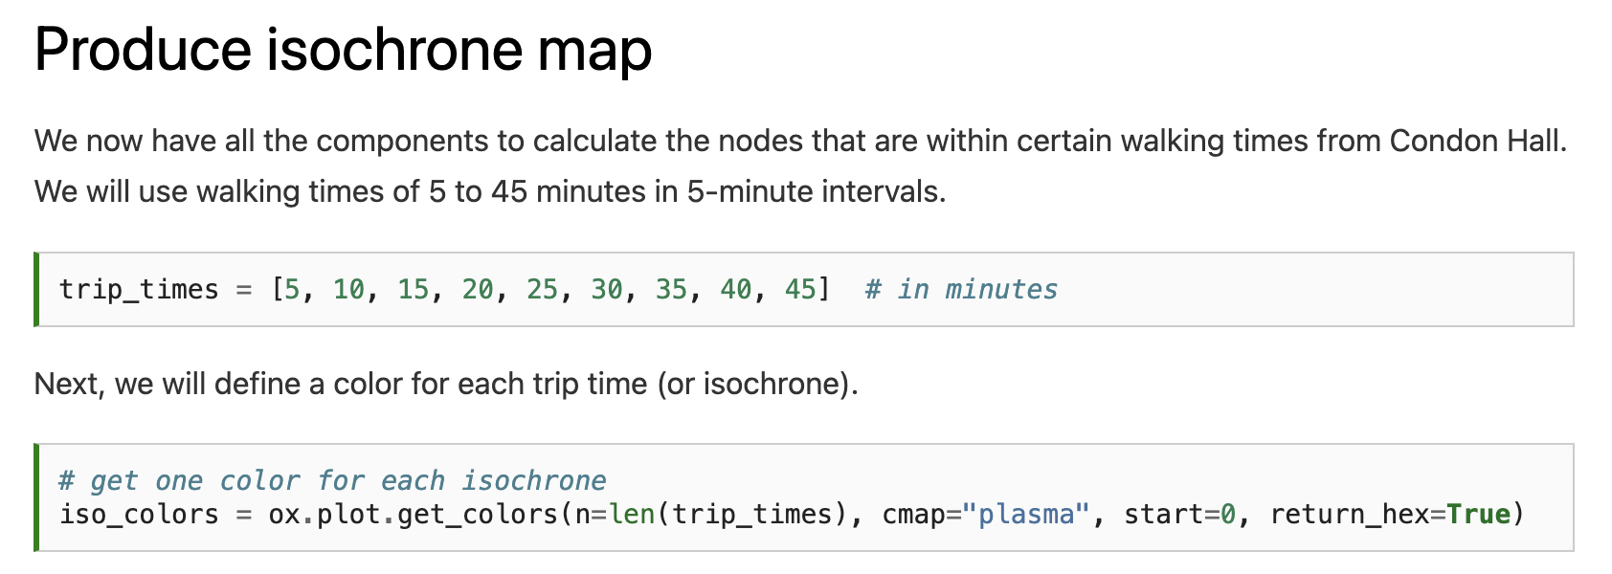

Slide 43
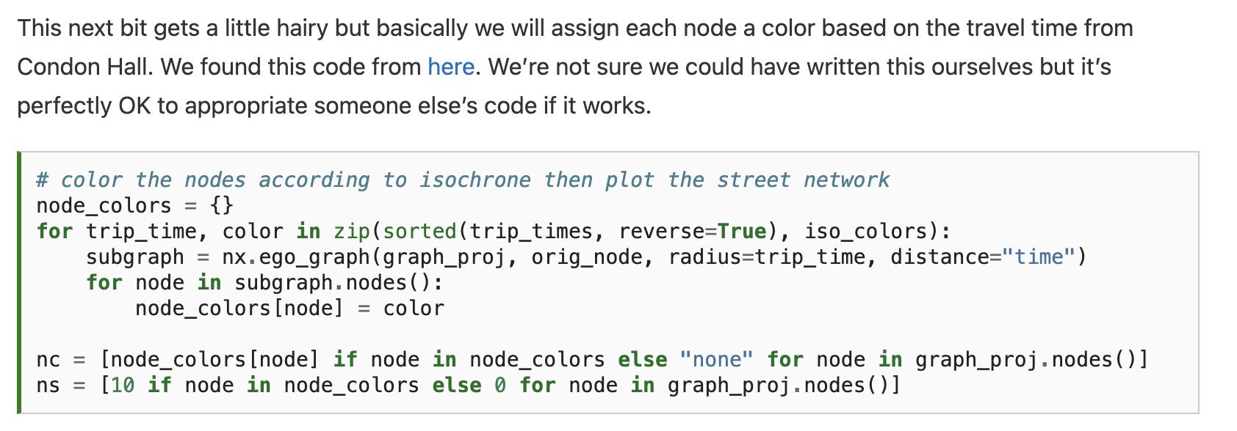

Slide 44
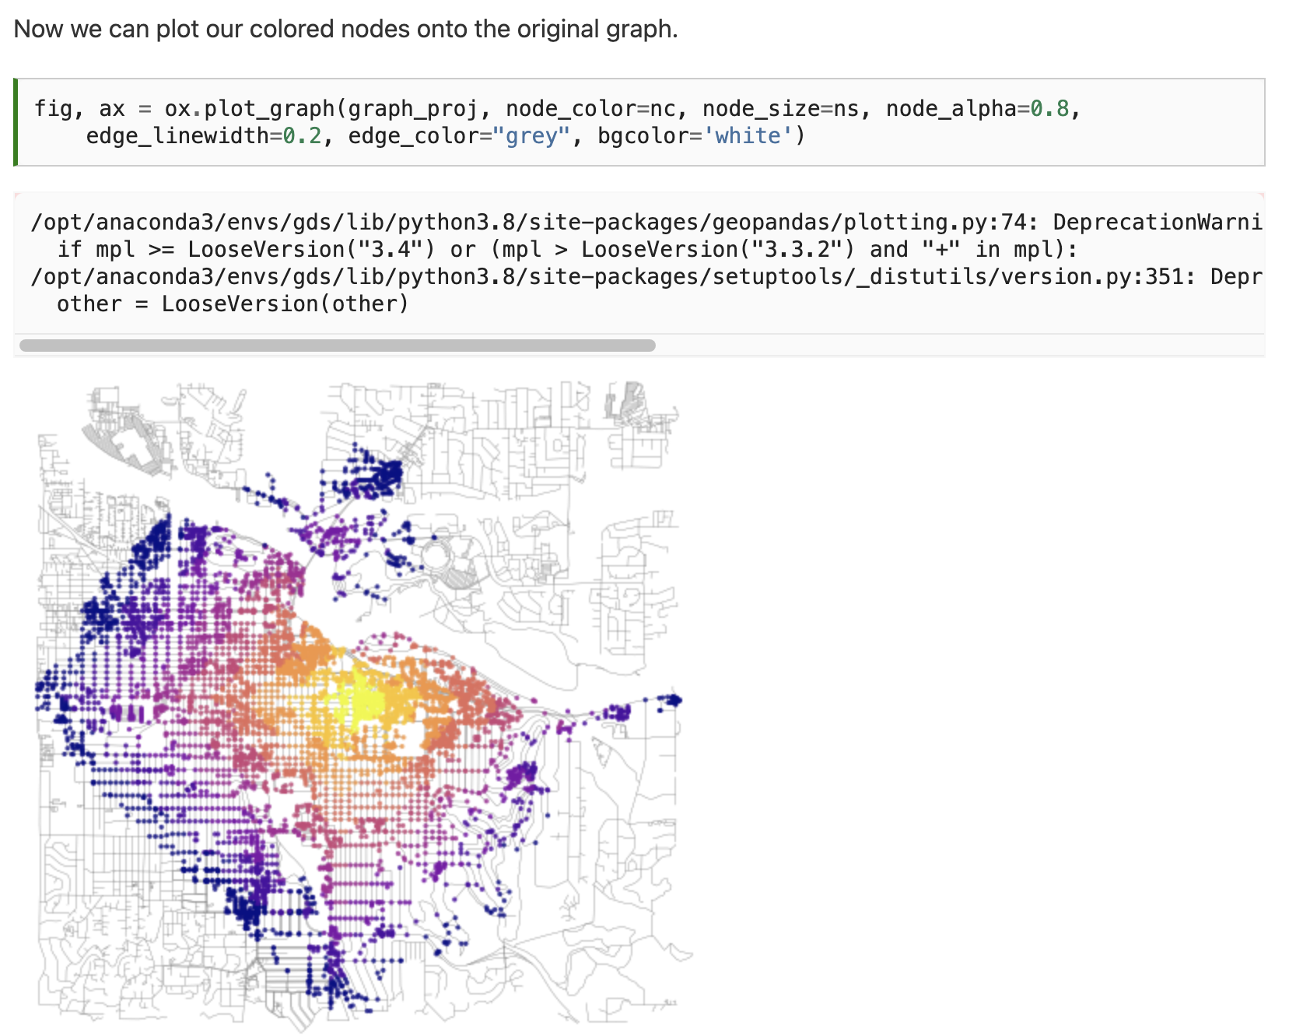
Notes:
This looks great but is of limited use since the buildings that we want to travel to are not necessarily associated with nodes. It would be more convenient to convert this data into polygons which we could use to intersect buildings (or points) of interest.

Slide 45
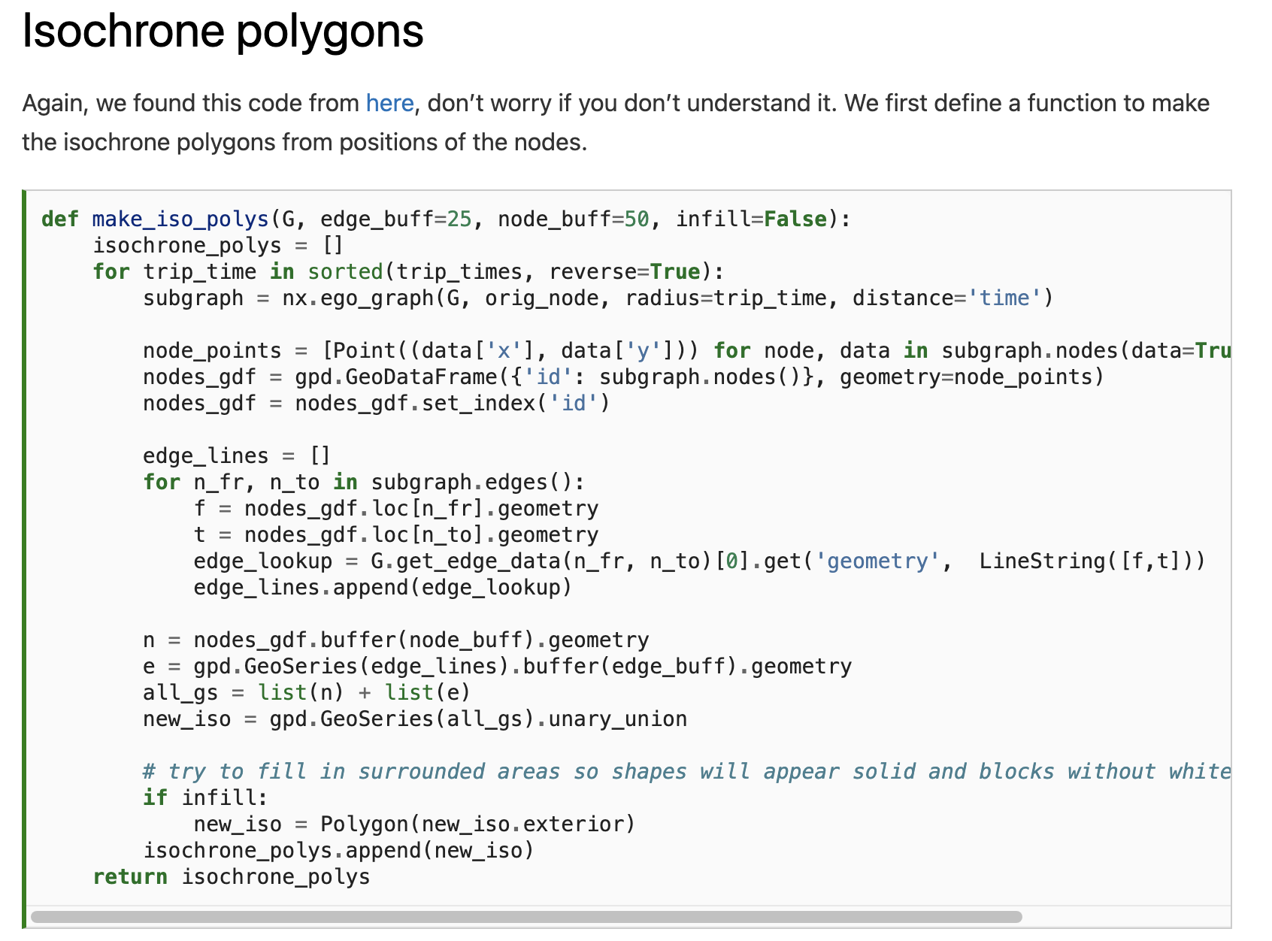
Notes:
This looks great but is of limited use since the buildings that we want to travel to are not necessarily associated with nodes. It would be more convenient to convert this data into polygons which we could use to intersect buildings (or points) of interest.

Slide 46
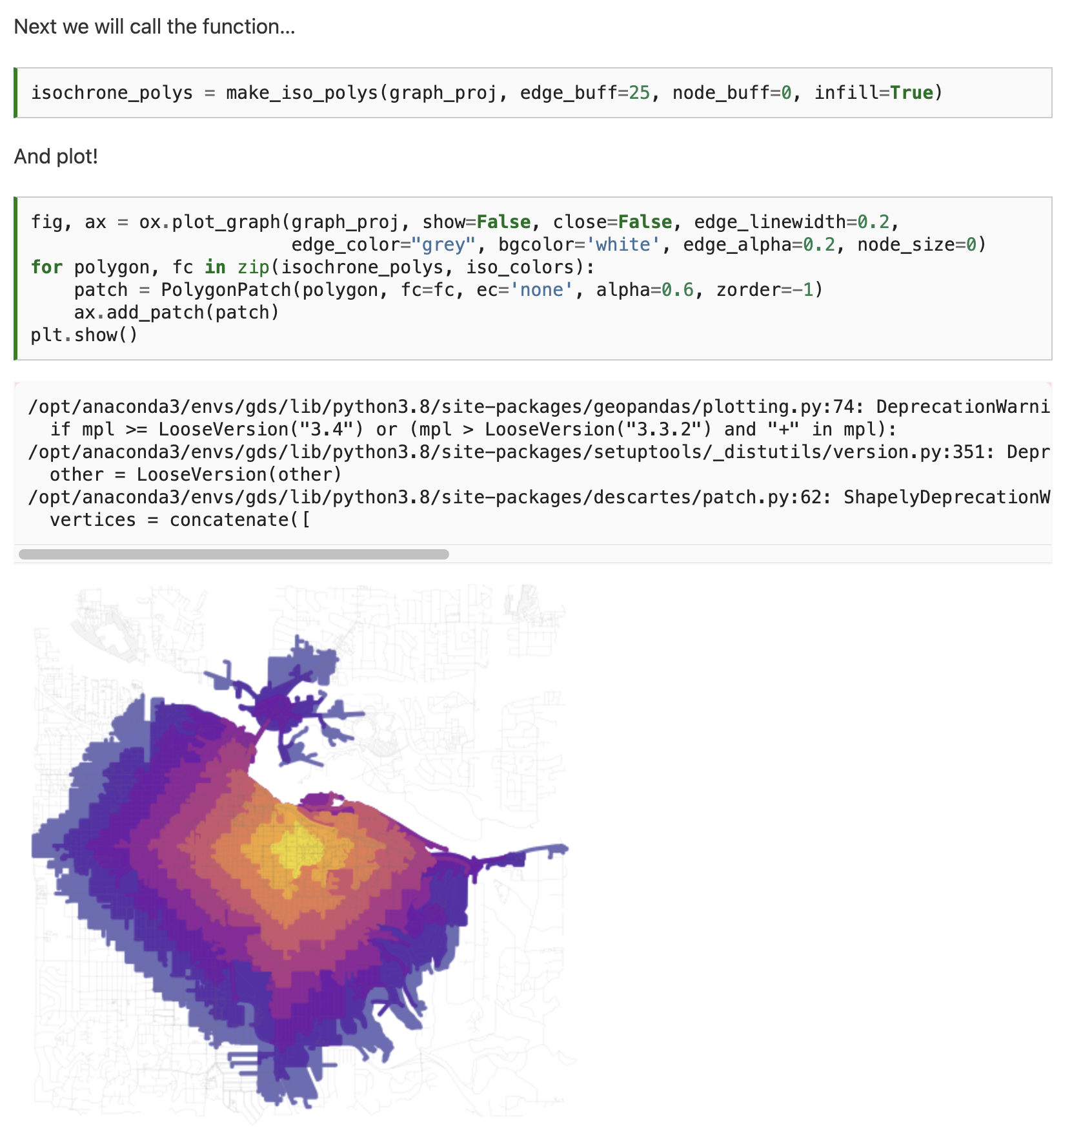
Notes:
This looks great but is of limited use since the buildings that we want to travel to are not necessarily associated with nodes. It would be more convenient to convert this data into polygons which we could use to intersect buildings (or points) of interest.

Slide 47
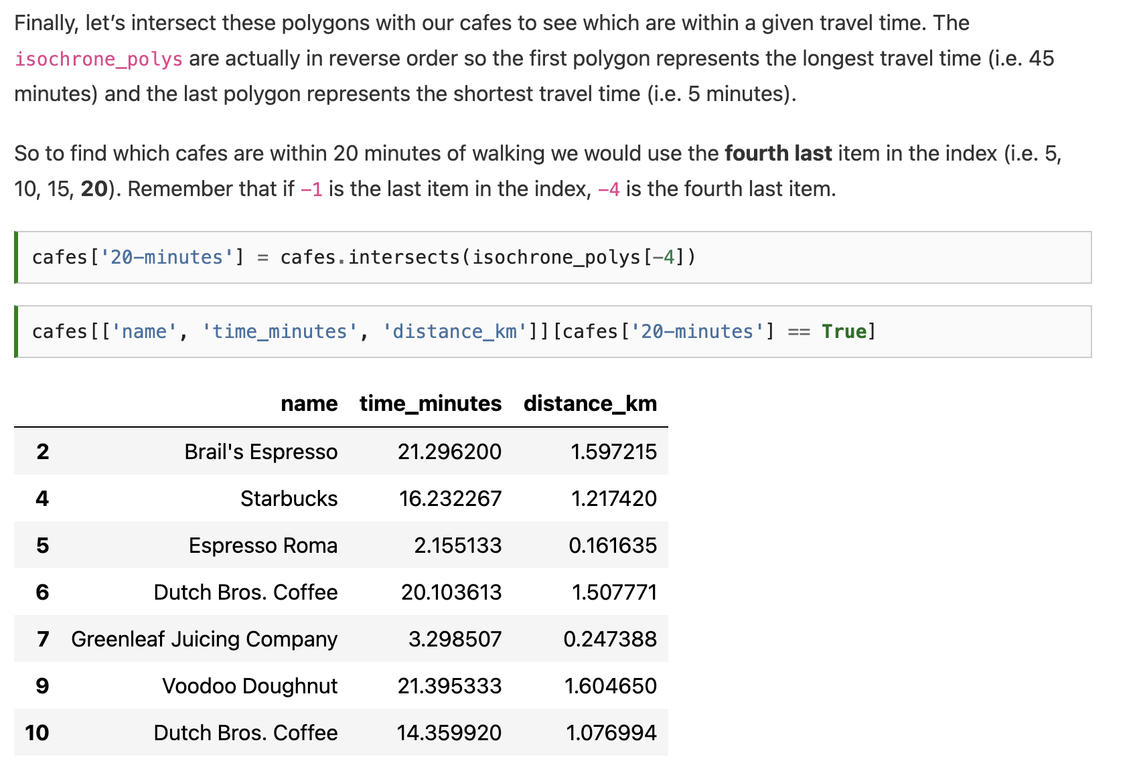
Notes:
This looks great but is of limited use since the buildings that we want to travel to are not necessarily associated with nodes. It would be more convenient to convert this data into polygons which we could use to intersect buildings (or points) of interest.

Slide 48
Notes:
This looks great but is of limited use since the buildings that we want to travel to are not necessarily associated with nodes. It would be more convenient to convert this data into polygons which we could use to intersect buildings (or points) of interest.

Slide 49
Next time: Gridded data analysis
Email: jryan4@uoregon.edu
Office: 163A Condon Hall
Office hours: Monday 15:00-16:00 and Tuesday 14:00-15:00

